Slide 1

Nomenclature of Bridge Compounds
Dr. Snigdha Roy
Assistant Professor
Department of Chemistry
B. B. College Asansol
Asansol-713303

Slide 2
Bridge Compounds
Some Important Definitions
Bridge head atom: A bridge head is any skeletal atom of the ring system which is bonded to three or more skeletal
atoms (excluding hydrogen). Bridge heads are common to all the rings.
Bridge: A bridge is an unbranched chain of atoms or an atom or a valence bond connecting two bridge heads.
Main Ring of Polycyclic system is selected in such a manner so that it includes as many skeletal atoms of the
polycyclic compound as possible.
Main bridge heads: These bridge heads must be linked by at least 3 bridges.
Main bridge: The main bridge connects between two main bridge heads.
Secondary Bridge is any bridge not included in the main bridge or in the main ring.
Independent secondary bridge links bridge head which are part of the main ring or main bridge.
Dependent Secondary Bridge links at least one bridge head which is a part of secondary bridge.

Slide 3
Example:
The following compound contains seven carbon atoms is, therefore, a bicycloheptane.

Slide 4
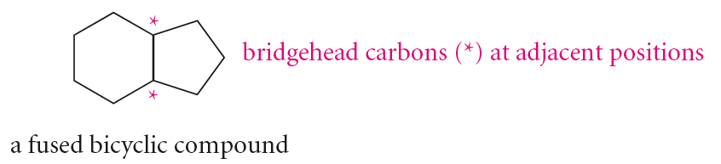
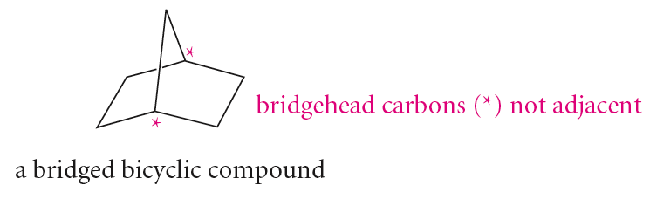
Fused and Bridged Compounds

Slide 5
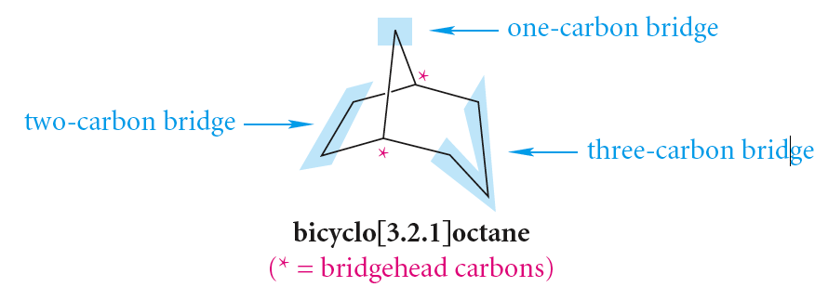
IUPAC Nomenclature of Bridge System
Indicate the number of rings using the prefix “bicyclo-”, “tricyclo-” etc.
Examine the bridge lengths.
Number the atoms starting from a main bridge head following the longest bridge of the main ring of the polycyclic system to reaching at the other bridge head position. Complete the counting by putting the last numbers sequentially on the smallest bridge of the compound.
Interpose in the name an expression in square brackets that denotes the number of carbon atoms in each bridge (in order of decreasing length) excluding the bridge heads.
So, here, the name of the hydrocarbon would be like the following:
It indicates the total number of skeletal atoms i.e. 8 (or octane)
Three bridges are there, in decreasing order of size that would be [3.2.1].

Slide 6
IUPAC Nomenclature of Bridge System
General
Naming
Rule:
Compound Type
(bicyclo/tricyclo etc.)
[ a . b . c . d ]
[placed in decending
Order i.e. a>b>c>d]
Parent alkane
Suffix including functional group
(-COOH, Ketone, C=C etc.)

Slide 7
IUPAC Nomenclature of Bridge System
  If substituents are present, number the bridged ring system starting from one bridgehead proceeding first along the longest bridge to the other bridgehead, then along the next longest bridge back to the first bridgehead. The shortest bridge is numbered last.
Prefix
Compound Type
(bicyclo/tricyclo etc.)
[ a . b . c . d ] Parent Alkane
[placed in descending
Order i.e. a>b>c>d]
Suffix including functional group
(-COOH, Ketone, C=C etc.)
Substituent
attached

Slide 8
IUPAC Nomenclature of Bridge Compounds

Slide 9
Thank You All…

